Slide 1
Principles of Distributed Database Systems
M. Tamer Özsu
Patrick Valduriez

Slide 2
Outline
Introduction
What is a distributed DBMS
History
Distributed DBMS promises
Design issues
Distributed DBMS architecture

Slide 3
Distributed Computing
A number of autonomous processing elements (not necessarily homogeneous) that are interconnected by a computer network and that cooperate in performing their assigned tasks.
What is being distributed?
Processing logic
Function
Data
Control
Notes:
There is a broader concept and inside that distributed database is a part.
Autonomous → Each individual things can do something and also connected to other severs.
Have own computing power and connected to other servers.
Distributed → Mostly we think data is distributed but process and other things can also be distributed.

Slide 4
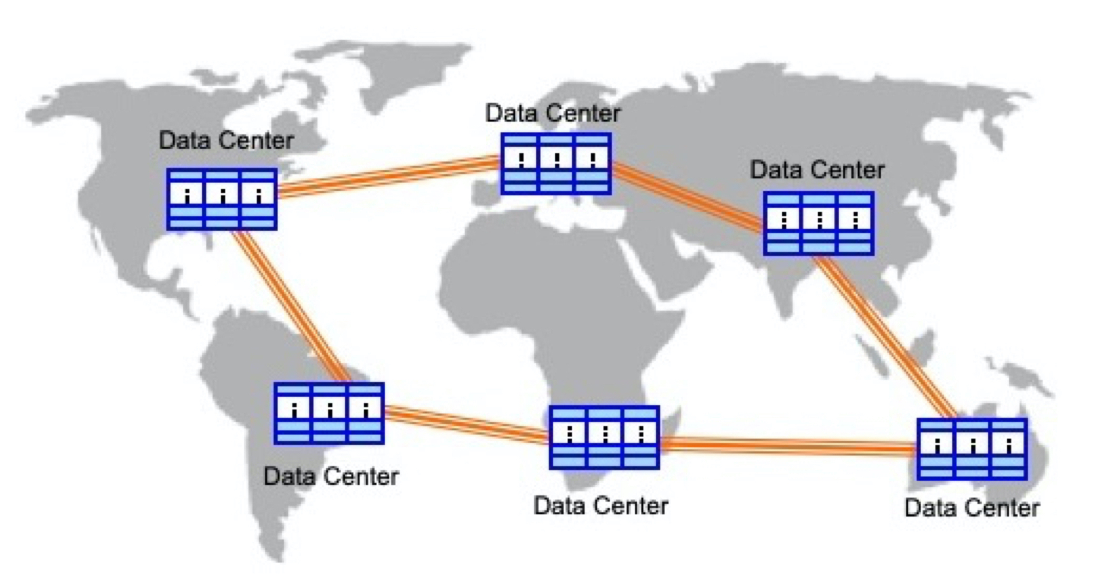
Current Distribution – Geographically Distributed Data Centers
Organizations have geographically distributed and interconnected data centers, each with hundreds or thousands of computers connected with high-speed networks, forming mixture of distributed and parallel systems

Slide 5
What is a Distributed Database System?
A distributed database is a collection of multiple, logically interrelated databases distributed over a computer network
A distributed database management system (Distributed DBMS) is the software that manages the DDB and provides an access mechanism that makes this distribution transparent to the users
Notes:
DDB - Distributed Database
Important is transparent

Slide 6
Motivation
Database
Technology
Computer
Networks
integration
distribution
Distributed
Database
Systems
integration
integration ≠ centralization
Notes:
Integration not Centralization Distributed DBMS promises

Slide 7
Centralized DBMS on a Network
Site 1
Site 2
Site 5
Communication
Network
Site 4
Site 3

Slide 8
Distributed DBMS Environment
Site 1
Site 2
Site 5
Communication
Network
Site 4
Site 3

Slide 9
Important Point
Logically integrated
but
Physically distributed

Slide 10
Outline
Introduction
What is a distributed DBMS
History
Distributed DBMS promises
Design issues
Distributed DBMS architecture

Slide 11
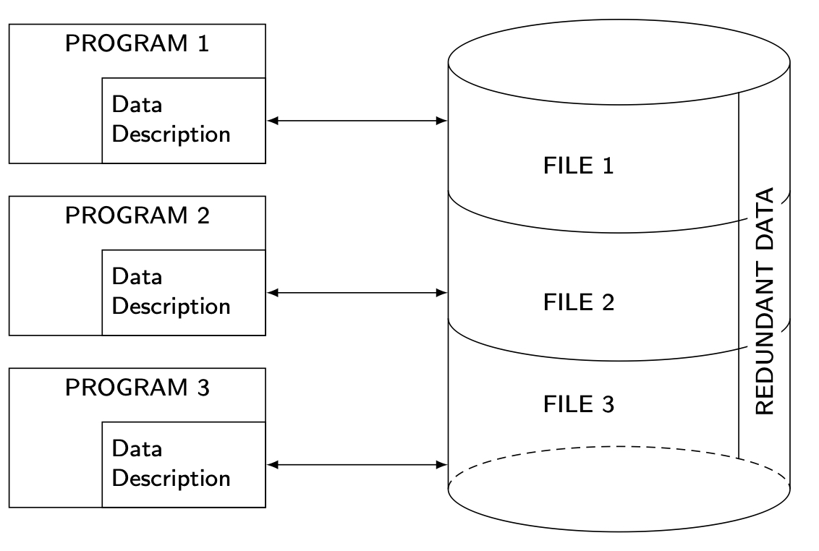
History – File Systems

Slide 12
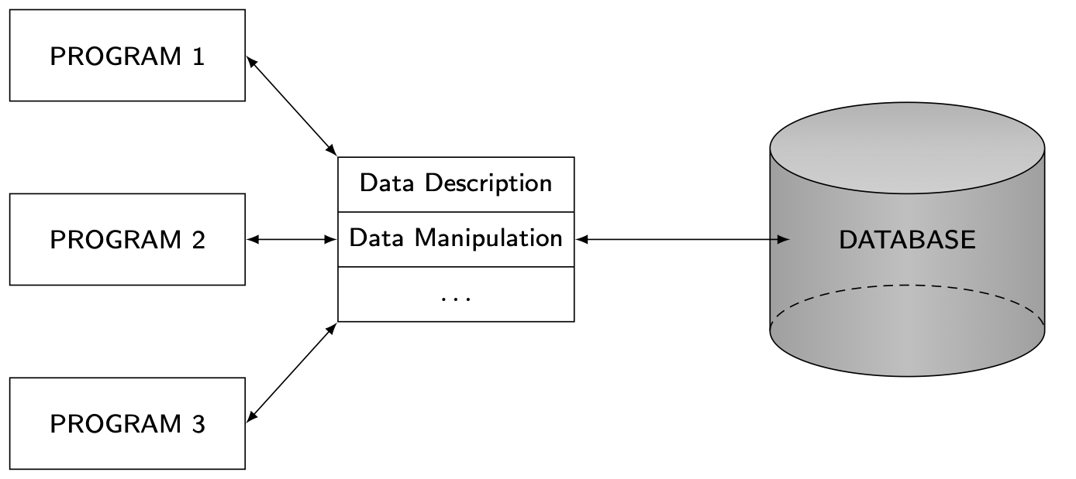
History – Database Management

Slide 13
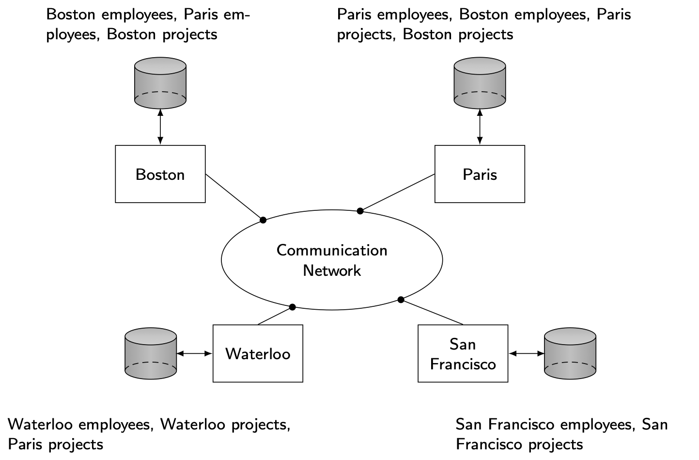
History – Early Distribution
Peer-to-Peer (P2P)

Slide 14
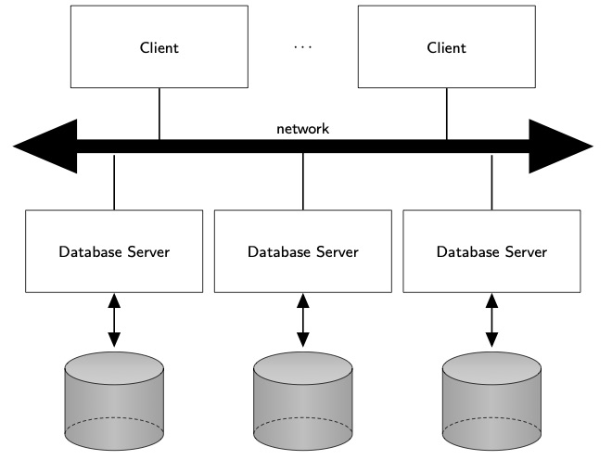
History – Client/Server

Slide 15
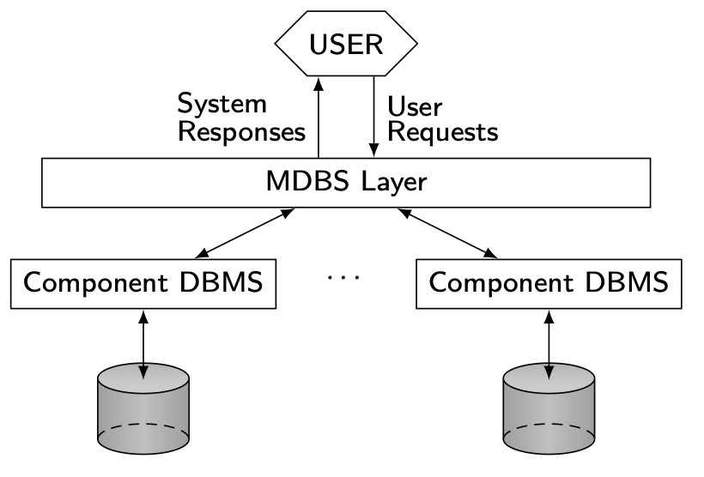
History – Multi Database Systems

Slide 16
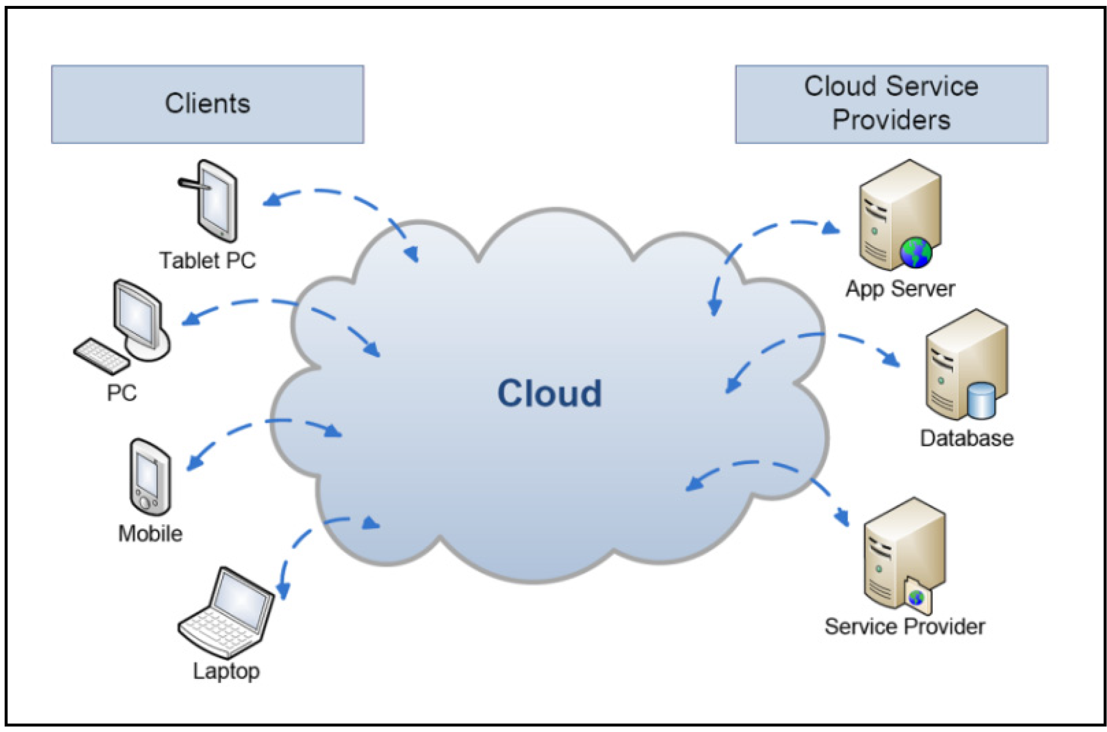
History – Cloud Computing
On-demand, reliable services provided over the Internet in a cost-efficient manner
Cost savings: no need to maintain dedicated compute power
Elasticity: better adaptivity to changing workload

Slide 17
Outline
Introduction
What is a distributed DBMS
History
Distributed DBMS promises
Design issues
Distributed DBMS architecture

Slide 18
Distributed DBMS Promises
Transparent management of distributed, fragmented, and replicated data
Improved reliability/availability through distributed transactions
Improved performance
Easier and more economical system expansion
Notes:
Fragmented → Split a single table into sub-tables and those sub-tables are distributed
Replication → Table 1 is in site-1 and also in site-2
Reliability → Is us like availability
Availability → It means its reliability

Slide 19
Transparency
Transparency is the separation of the higher-level semantics of a system from the lower level implementation issues.
Fundamental issue is to provide
data independence
in the distributed environment
Network (distribution) transparency
Replication transparency
Fragmentation transparency
horizontal fragmentation: selection
vertical fragmentation: projection
hybrid
Notes:
Ex: If I want to add or delete an attribute to a table it should be able to do.
To provide transparency we need to provide data independence.
Types
Network transparency
Replication transparency
Fragmentation transparency

Slide 20
Data Independence
The immunity of user applications to changes in the definition and organization of data, and vice versa.
Two levels of data definition.
The logical structure of the data: Schema definition.
The physical structure of the data: Physical data description.
Therefore, there are two types of data independence:
Logical data independence: the immunity of user applications to changes in the logical structure (i.e., schema change such as addition of new attributes) of the database.
Physical data independence: hiding the details of the storage structure from user applications such as storage structure changes.
The user application should not need to be modified when data organization (either logical or physical) changes occur.
Notes:
2 levels possible:
Logical
Physical
Schema Definition means → Table head
Relationship between tables → Primary key and Foreign Key

Slide 21
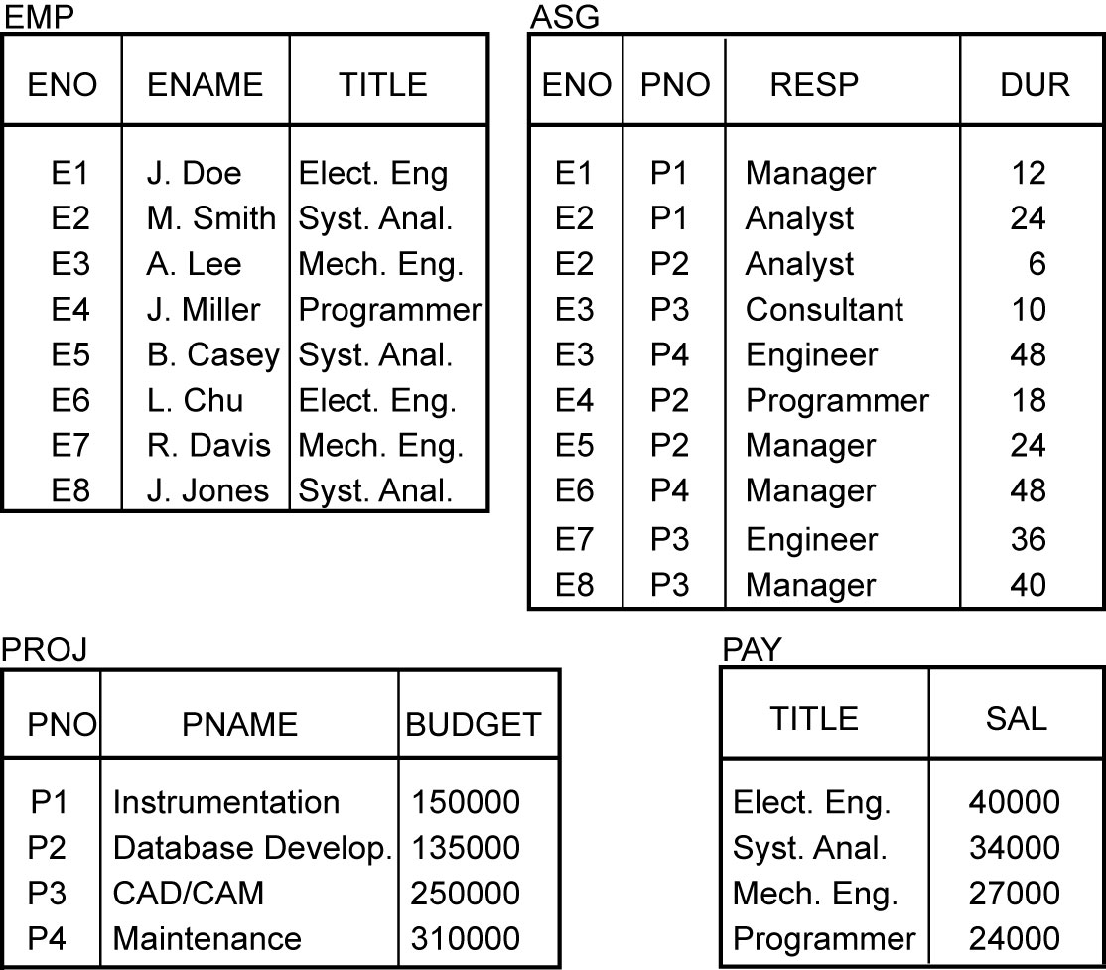
Example

Slide 22
Transparent Access
Tokyo
SELECT ENAME,SAL
FROM EMP,ASG,PAY
WHERE DUR > 12
AND EMP.ENO = ASG.ENO
AND PAY.TITLE = EMP.TITLE
Boston
Paris
Paris projects
Paris employees
Paris assignments
Boston employees
Communication
Network
Boston projects
Boston employees
Boston assignments
Montreal
New
York
Montreal projects
Paris projects
New York projects
with budget > 200000
Montreal employees
Montreal assignments
Boston projects
New York employees
New York projects
New York assignments
Notes:
Animated slide

Slide 23
Distributed Database - User View
Distributed Database

Slide 24
Distributed DBMS - Reality
User
Query
DBMS
Software
User
Application
DBMS
Software
DBMS
Software
Communication
Subsystem
User
Application
DBMS
Software
User
Query
DBMS
Software
User
Query

Slide 25
Types of Transparency
Network (distribution) transparency
Replication transparency
Fragmentation transparency
horizontal fragmentation: selection
vertical fragmentation: projection
hybrid

Slide 26
Network transparency
The user should be protected from the operational details of the network; possibly even hiding the existence of the network.
In terms of users point, there should be no difference between database applications that run on a centralized database and those that run on a distributed database.
This type of transparency is referred to as network transparency.

Slide 27
Network transparency
Two types of network transparency are identified: location transparency and naming transparency.
Location transparency refers that the command used to perform a task is independent of both the location of the data and the system on which an operation is carried out.
Naming transparency means that a unique name is provided for each object in the database.
Notes:
2 Types:
Location transparency
Naming transparency
ENO, EmpNO, etc should be allowed

Slide 28
Replication transparency
Replication transparency issue is whether the users should be aware of the existence of copies or whether the system should handle the management of copies and the user should act as if there is a single copy of the data.
From a user’s perspective the answer is obvious. It is preferable not to be involved with handling copies and having to specify the fact that a certain action can and/or should be taken on multiple copies.
From a systems point of view, however, the answer is not that simple. So, it is desirable that replication transparency be provided as a standard feature of DBMSs.
Notes:
If site-1 is updated then site-2 is updated if a table in site-1 and site-2 are replicated.

Slide 29
Fragmentation transparency
It is desirable to divide each database relation into smaller fragments and treat each fragment as a separate database object (i.e., another relation).
This is commonly done for reasons of performance, availability, and reliability.
Fragmentation transparency
horizontal fragmentation: selection
vertical fragmentation: projection
Hybrid
The issue is to find a query processing strategy based on the fragments rather than the relations, even though the queries are specified on the latter (relations).
Notes:
One table into sub-tables
Horizontal (cut like this -) and vertical (cut like this |) fragmentation also is possible

Slide 30
Reliability Through Transactions
Replicated components and data should make distributed DBMS more reliable.
Distributed transactions provide
Concurrency
Transparency
Atomicity
Distributed transaction requires implementation of
Distributed concurrency control protocols
Commit protocols
Data replication
Great for read-intensive workloads, problematic for updates
Replication protocols
Notes:
Atomicity → Query done completely or not done at all
Consistency → Correctness (One bank can allow a negative balance and another may not)
Isolation →
Durability → Query results must be permanently available. Store in disk (multiple disks so if one disk fails then there is a backup)

Slide 31
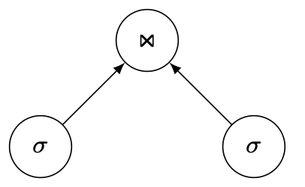
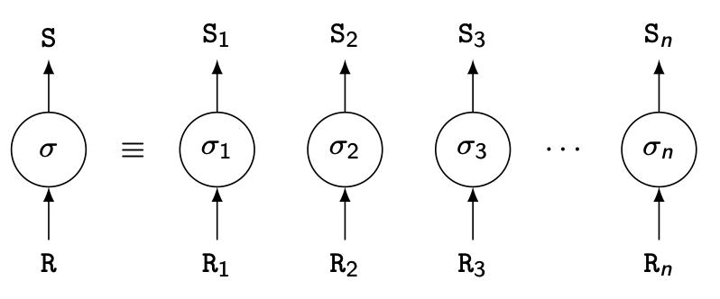
Potentially Improved Performance
Proximity of data to its points of use
Requires some support for fragmentation and replication
Parallelism in execution
Inter-query parallelism
Intra-query parallelism

Slide 32
Scalability
In a distributed environment, it is much easier to accommodate increasing database sizes and bigger workloads.
System expansion can usually be handled by adding processing and storage power to the network.
Obviously, it may not be possible to obtain a linear increase in “power,” since this also depends on the overhead of distribution. However, significant improvements are still possible.
That is why distributed DBMSs have gained much interest in scale-out architectures in the context of cluster and cloud computing.
Scale-out (also called horizontal scaling) refers to adding more servers, called “scale-out servers” in a loosely coupled fashion, to scale almost infinitely.
By making it easy to add new component database servers, a distributed DBMS can provide scale-out.

Slide 33
Outline
Introduction
What is a distributed DBMS
History
Distributed DBMS promises
Design issues
Distributed DBMS architecture

Slide 34
Distributed DBMS Issues
Distributed database design
How to distribute the database
Replicated & non-replicated database distribution
A related problem in directory management
Distributed query processing
Convert user transactions to data manipulation instructions
Optimization problem
min{cost = data transmission + local processing}
General formulation is NP-hard

Slide 35
Distributed DBMS Issues
Distributed concurrency control
Synchronization of concurrent accesses
Consistency and isolation of transactions' effects
Deadlock management
Reliability
How to make the system resilient to failures
Atomicity and durability
Notes:
Concurrency control → Some queries need to wait for others to complete

Slide 36
Distributed DBMS Issues
Replication
Mutual consistency
Freshness of copies
Eager vs lazy
Centralized vs distributed
Parallel DBMS
Objectives: high scalability and performance
Cluster computing

Slide 37
Outline
Introduction
What is a distributed DBMS
History
Distributed DBMS promises
Design issues
Distributed DBMS architecture

Slide 38
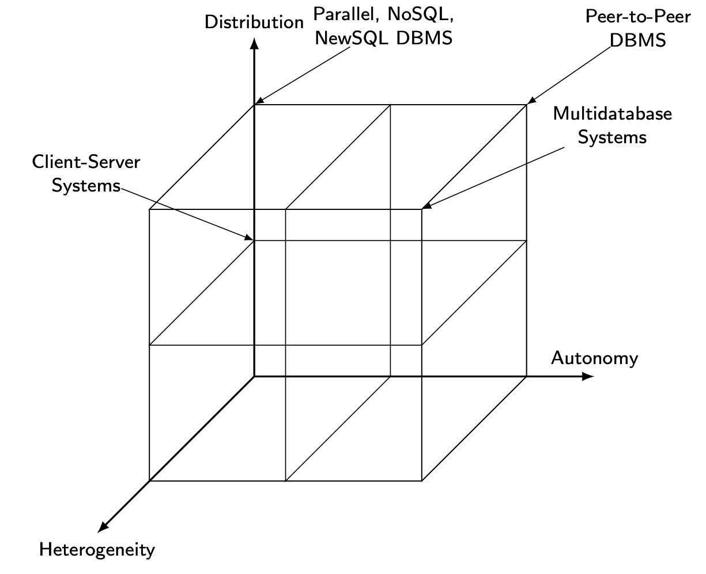
DBMS Implementation Alternatives

Slide 39
Dimensions of the Problem
Distribution
Whether the components of the system are located on the same machine or not
Heterogeneity
Various levels (hardware, communications, operating system)
data model, query language, transaction management algorithms
Autonomy
Not well understood and most troublesome
Various versions
Design autonomy: Ability of a component DBMS to decide on issues related to its own design.
Communication autonomy: Ability of a component DBMS to decide whether and how to communicate with other DBMSs.
Execution autonomy: Ability of a component DBMS to execute local operations in any manner it wants to.

Slide 40
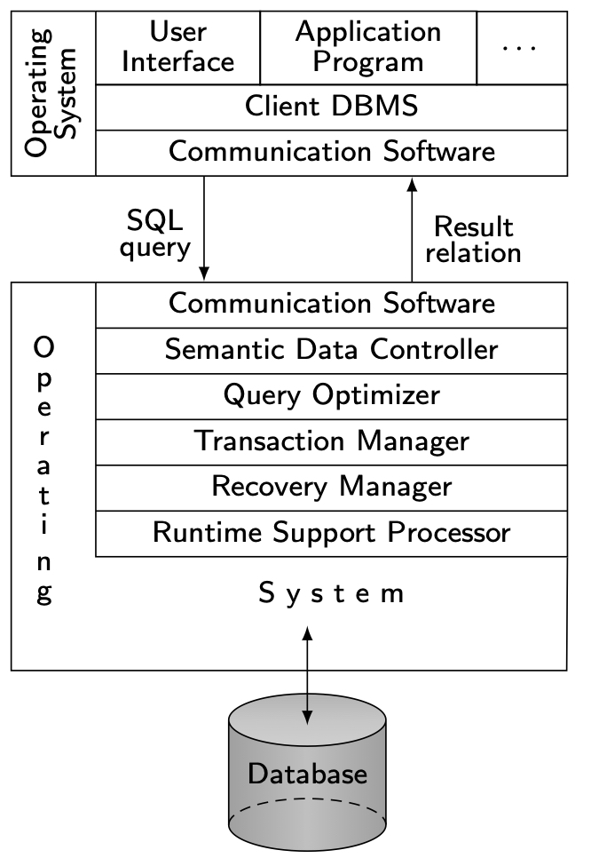
Client/Server Architecture

Slide 41
Advantages of Client-Server Architectures
More efficient division of labor
Horizontal and vertical scaling of resources
Better price/performance on client machines
Ability to use familiar tools on client machines
Client access to remote data (via standards)
Full DBMS functionality provided to client workstations
Overall better system price/performance
Notes:
Vertical and Horizontal Scaling

Slide 42
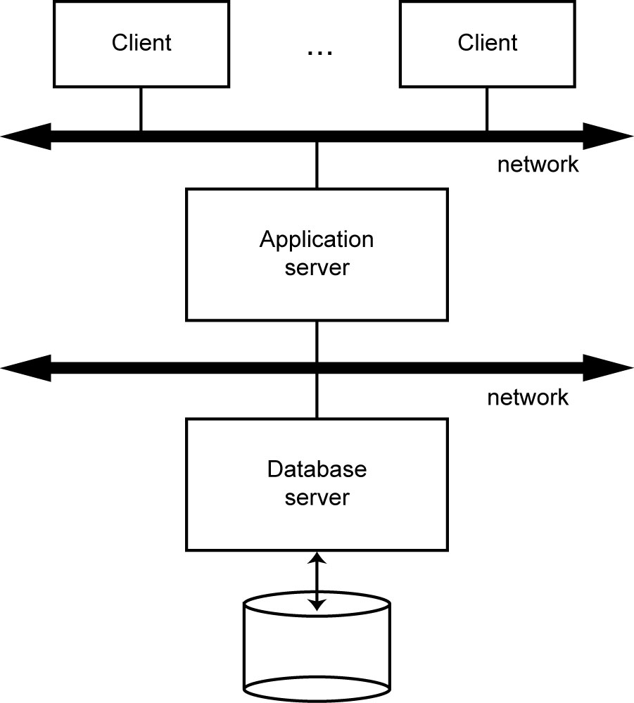
Database Server (Multiple Clients / Single Server)

Slide 43
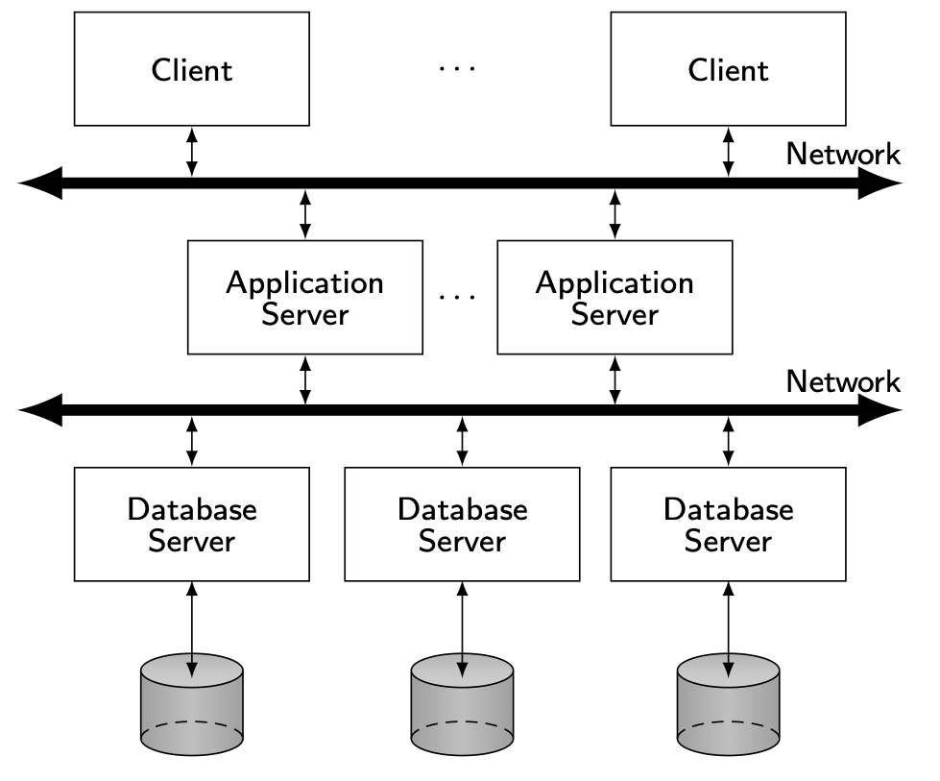
Distributed Database Servers (Multiple Clients / Multiple Servers)

Slide 44
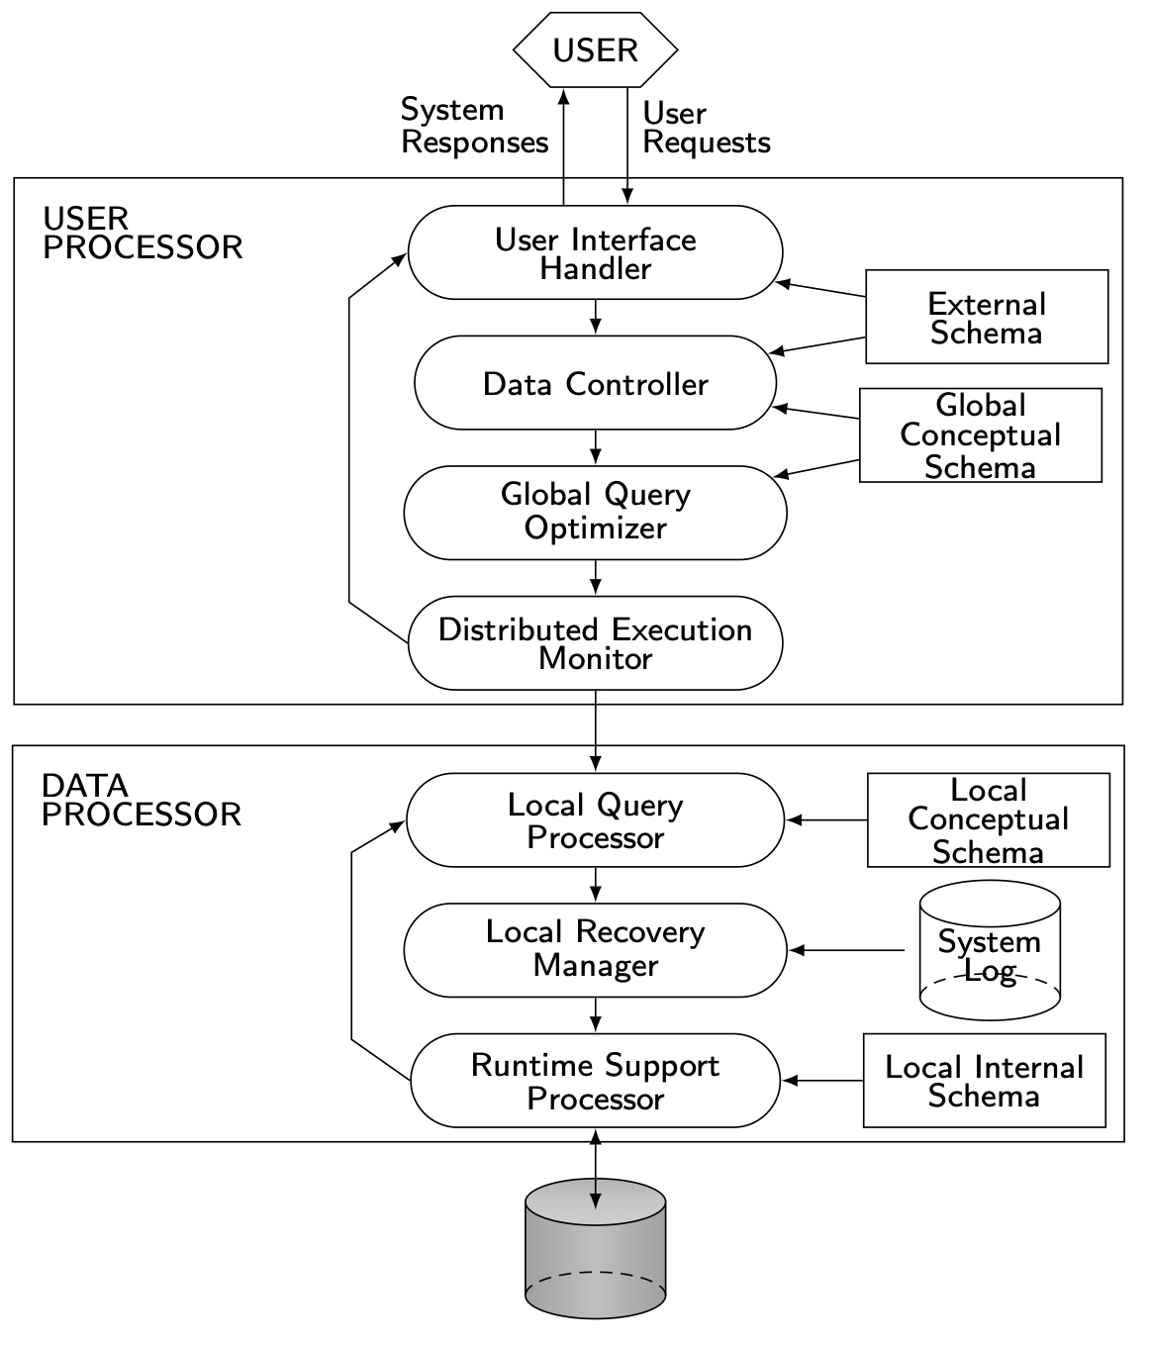
Peer-to-Peer Component Architecture

Slide 45
MDBS Components & Execution
MDBS has 2 options, Homogeneous and Heterogeneous.

Slide 46
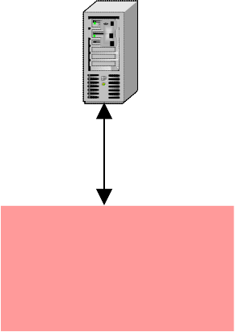

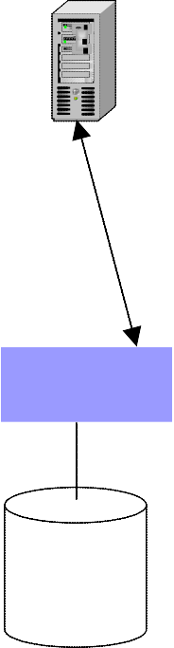
Homogeneous vs. Heterogeneous
Global user
Homogeneous DDBMS
No local users
Most systems do not have local external schemas
Local user
Local user
Multidatabase Management system
Heterogeneous DDBMS
There are both local and global users
It can be split into:
Tightly Coupled Systems: have a global conceptual schema
Loosely Coupled Systems: do not have a global conceptual schema.
DBMS
DBMS
DBMS
DBMS
Database 1
Database 2
Database 3
Database 4

Slide 47
Cloud Computing
It encompasses on demand, reliable services provided over the Internet (typically represented as a cloud) with easy access to virtually infinite computing, storage, and networking resources.
Through very simple web interfaces and at small incremental cost, users can outsource complex tasks, such as data storage, database management, system administration, or application deployment, to very large data centers operated by cloud providers.
Thus, the complexity of managing the software/hardware infrastructure gets shifted from the users’ organization to the cloud provider

Slide 48
Cloud Computing
The cloud provides various levels of functionality such as:
Infrastructure-as-a-Service (IaaS): the delivery of a computing infrastructure (i.e., computing, networking, and storage resources) as a service;
Platform-as-a-Service (PaaS): the delivery of a computing platform with development tools and APIs as a service;
Software-as-a-Service (SaaS): the delivery of application software as a service; or
Database-as-a-Service (DaaS): the delivery of database as a service.

Slide 49
Cloud Computing
The typical advantages of cloud computing are the followings:
Cost. The cost for the customer can be greatly reduced since the infrastructure does not need to be owned and managed;
Ease of access and use. The cloud hides the complexity of the IT infrastructure and makes location and distribution transparent. Thus, customers can have access to IT services anytime, and from anywhere with an Internet connection.
Quality of service. The operation of the IT infrastructure by a specialized provider that has extensive experience in running very large infrastructures increases quality of service and operational efficiency.

Slide 50
Cloud Computing
The typical advantages of cloud computing are the followings:
Innovation. Using state-of-the-art tools and applications provided by the cloud encourages modern practice, thus increasing the innovation capabilities of the customers.
Elasticity. The ability to scale resources out, up and down dynamically to accommodate changing conditions is a major advantage. This is typically achieved through server virtualization, a technology that enables multiple applications to run on the same physical computer as virtual machines (VMs), i.e., as if they would run on distinct physical computers.

Slide 51
Architecture of Cloud site (Data Center)
It has typically 3-tier.
The first tier consists of web clients that access cloud web servers, typically via a router or load balancer at the cloud site.
The second tier consists of web/application servers that support the clients and provide business logic.
The third tier consists of database servers.
Thus, the cloud architecture provides two levels of distribution:
geographical distribution across sites using a WAN and
within a site, distribution across the servers, typically in a computer cluster.
The techniques
used at the first level are those of geographically distributed DBMS,
while the techniques used at the second level are those of parallel DBMS.

Slide 52
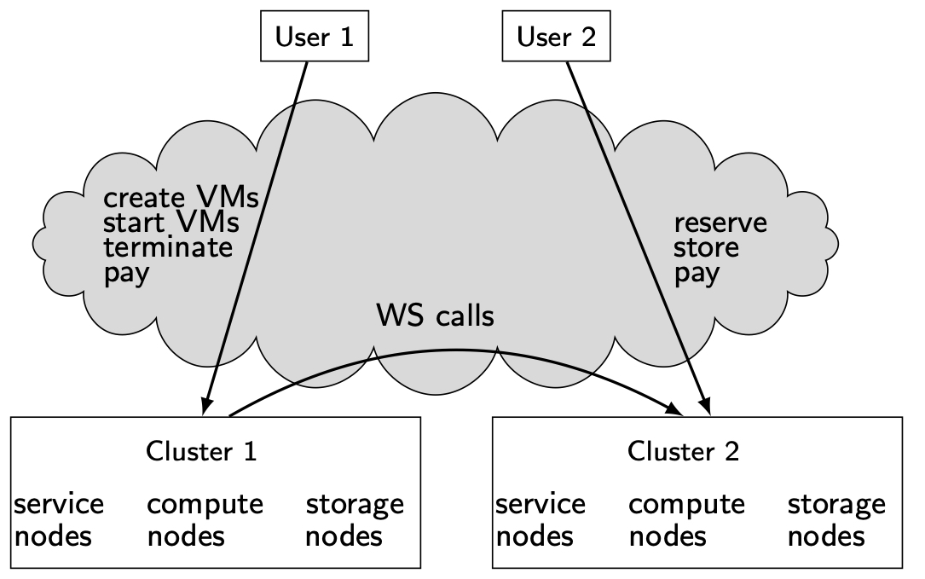
Simplified Cloud Architecture
VM: Virtual Machine
WS: Web Services

